Slide 1

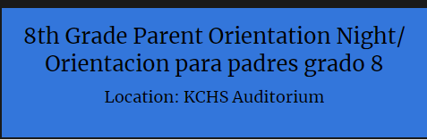
Please follow along on your cell phones
Go to kingcityhs.org
Look on the right under "Calendar"
Choose the English or Spanish presentation that you would like to view
Por favor siga en sus teléfonos celulares
Vaya al sitio kingcityhs.org
En la parte a la derecha oprima "Calendar"
Escoja la presentacion que usted gustaria ver en Ingles o Español

Slide 2

8th Grade Pre Programming
Welcome future Mustangs!

Slide 3
Are you ready for high school?
We are here to help you understand...
Pre-programming process and its purpose.
Overview of our offered student courses.
Get to know our faculty and support staff.
School resources and extra-curricular activities.

Slide 4
King City High School
Counseling Is Coming to Your School
Parents are encouraged to attend the pre-programming session.
If you miss your pre-programming date, contact the counseling office as soon as possible.
Review and discuss your student’s pre-programming class options. Deadline for changes will be March 1st, after that class changes may be difficult and at times impossible.
School | Date | Time
San Lucas | Jan 28th | 1:00 pm
Bitterwater | Jan 28th | 10:00 am
San Antonio | Jan 27th | 1:00 pm
San Ardo | Jan 27th | 9:00 am
Chalone Peaks | Feb 6th (during History) | All day

Slide 5

Counselors 25/26 School Year
Ms. Cawley
  9th, A-Ga
  and 12th grade
Mr. Martin
  9th, Ge-O
  and 10th grade
Ms. Martinez
  9th, P-Z and 11th grade
For appointments contact our Student Service Technician, Yvonne Hernandez at
831-385-5461 ext. 3251

Slide 6
KCHS Graduation Requirements
English
Eng 1
Eng 2
Math
Two Years
Science
Science Academy 1
Science Academy 2
Eng 3
Eng 4
Econ (1 sem)
World History
US History
Civics (1 sem)
Social Science
Ethnic Studies (1 Sem)
Health
One semester
Computers
Comp App Intro CP
Fine Art
One Year
Electives
85 Credits
Two Years
PE
Total 240 Credits

Slide 7
A-G Requirements
English
Eng 1
Eng 2
Math
Math 1
Science
Sci Academy 1
Sci Academy 2
Eng 3
Eng 4
Math 2
Math 3
4th year*
3rd year lab*
Social Science
World History
US History
Fine Art
1 Year
CP Elective
One Course
LOTE
Two Years Spanish, three recommended

Slide 8

9th Grade Required Classes: English, Math, PE, Science, Health and Ethnic Studies

Slide 9

English 1 Honors
An honors student is...
Interested in reading and writing
Interested in multiple perspectives and critical thinking
Interested in sharing ideas and voicing their opinion
Interested in reading the same piece of text multiple times for deeper meaning
Subject to stricter grading principles

Slide 10
Things to remember...
No pre requisite
No summer assignment for incoming 9th grade, 10th grade is determined by the teacher
There is no formal assessment such as an AP exam
This program is intended to keep students on an AP pathway in English their junior and senior year
There is not 'more work' but more to do with the work we have
You are expected to participate, have good attendance, ask questions, read aloud and stand-out from students in a college prep class

Slide 11


Math Courses
9th grade $→$
Math 1
or
Math 1 Honors
C or better
C
B or better
Math 2
Math 2 Honors
10th grade $→$
If a 9th grade student earns a grade below a C (D or F), the course must be repeated:
Summer school or Math 1B the next year

Slide 12
Physical Education
Class of 2029. Start your freshman year off right. Be successful by dressing out and participating in physical education activities. You must pass two years of PE to graduate.
KCHS offers: Badminton, soccer, volleyball, ultimate frisbee, speedball, basketball, flag football and pickleball to name a few.
KCHS requires students to dress out. ALL Freshmen will receive free shirt and shorts. We require students wear a gray t-shirt and royal blue shorts. Students may bring their own or we also have clothes to sell ONLY on the first week of school.
Prices: T-shirt $8 Shorts $8 Sweatshirt $20

Slide 13

Athletic Physical Education
Students will be lifting weights and improving athletic movements
Why?
After school athletics is a great thing for students, but students get home late and have less time for homework and studying. This class allows students to still practice for their after-school sports, but they can get home earlier do to not needing to lift weights and practice afterschool
Additionally, students will be exercising year-round which will help students stay healthy and not have pain or miss school recovering from athletic injury
Who?
Students who are on an athletic team, or who plan to be on an athletic team during the school year

Slide 14
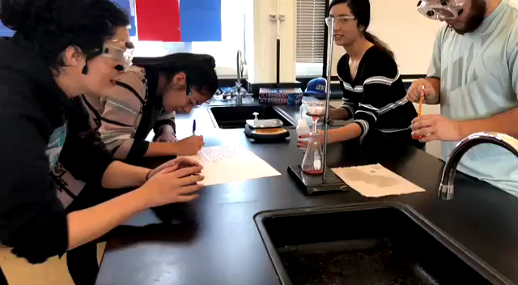
Integrated Science:
  Science Academy 1 & 2 preparation for college in science and tech fields:
      Nursing & Medical
      Green Energy Technologies
      Engineering
Inquiry Based Learning
Science at King City High School

Slide 15
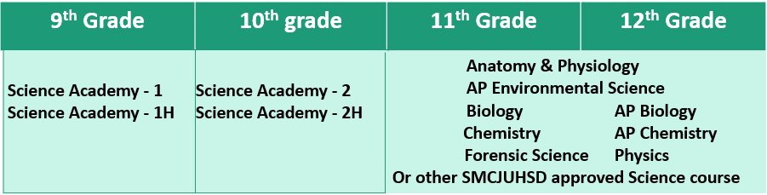
Why Integrated Science?
•Responds to the needs of our changing world
•Provides the best science experience for ALL students
Dual Enrollment Chemistry Dual Enrollment Biology

Slide 16
Science Academy 1 & 2 and Honors*
Students in Science Academy 1 & 2 will use science and engineering practices to solve real world problems
SA 1& 2 Topics covered
Earth's Histroy and Evolution
Space
Laws of Motion and Physics
Cell Biology
Energy and Ecosystems
Students in Honor classes will follow the same topics, but will demonstrate a broader range of science writing and analysis skills by the end of the year to introduce them to the rigor of college and careers in science.

Slide 17
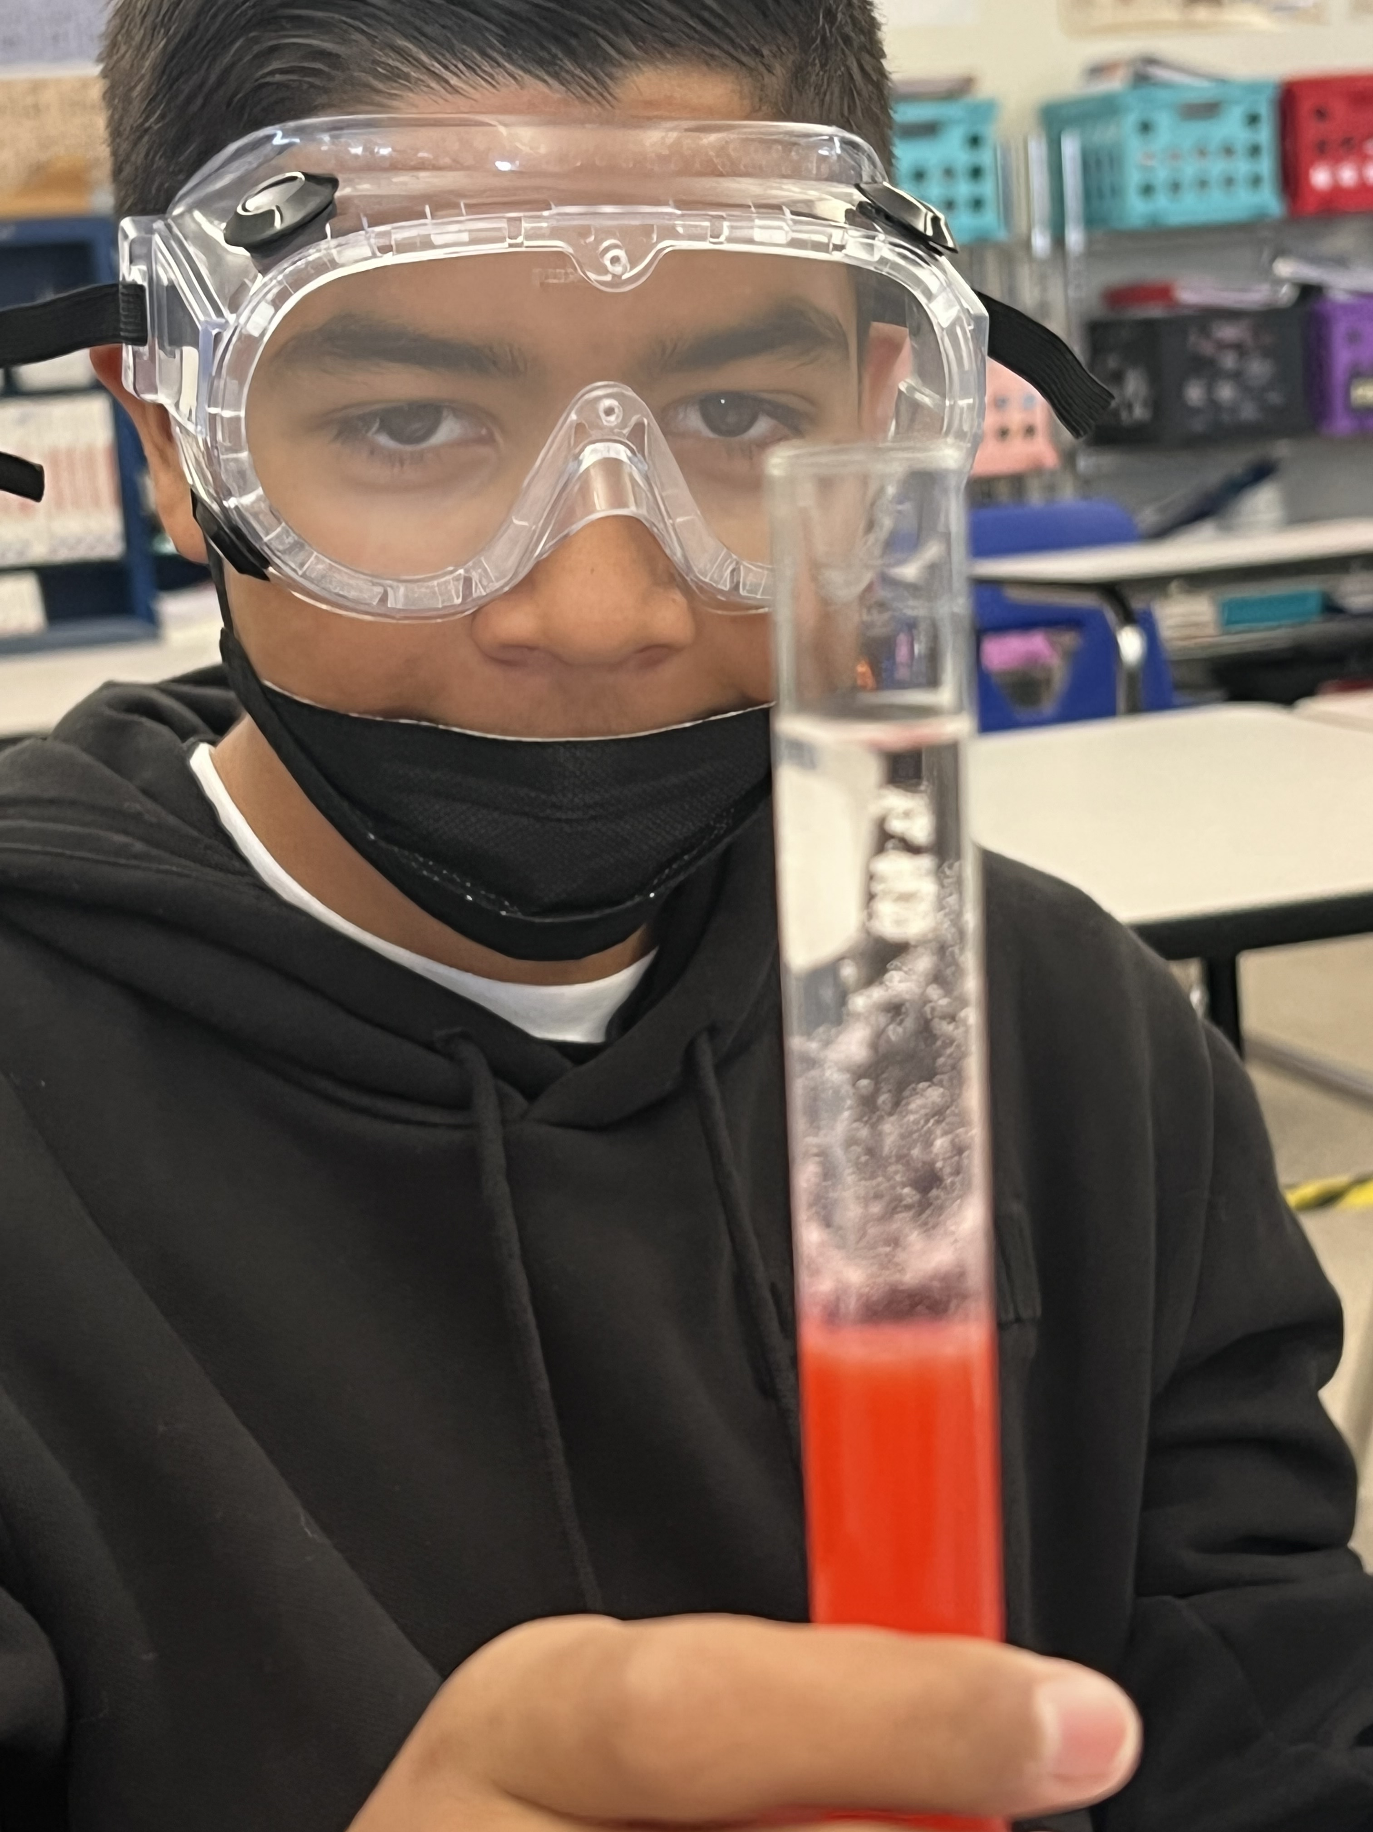
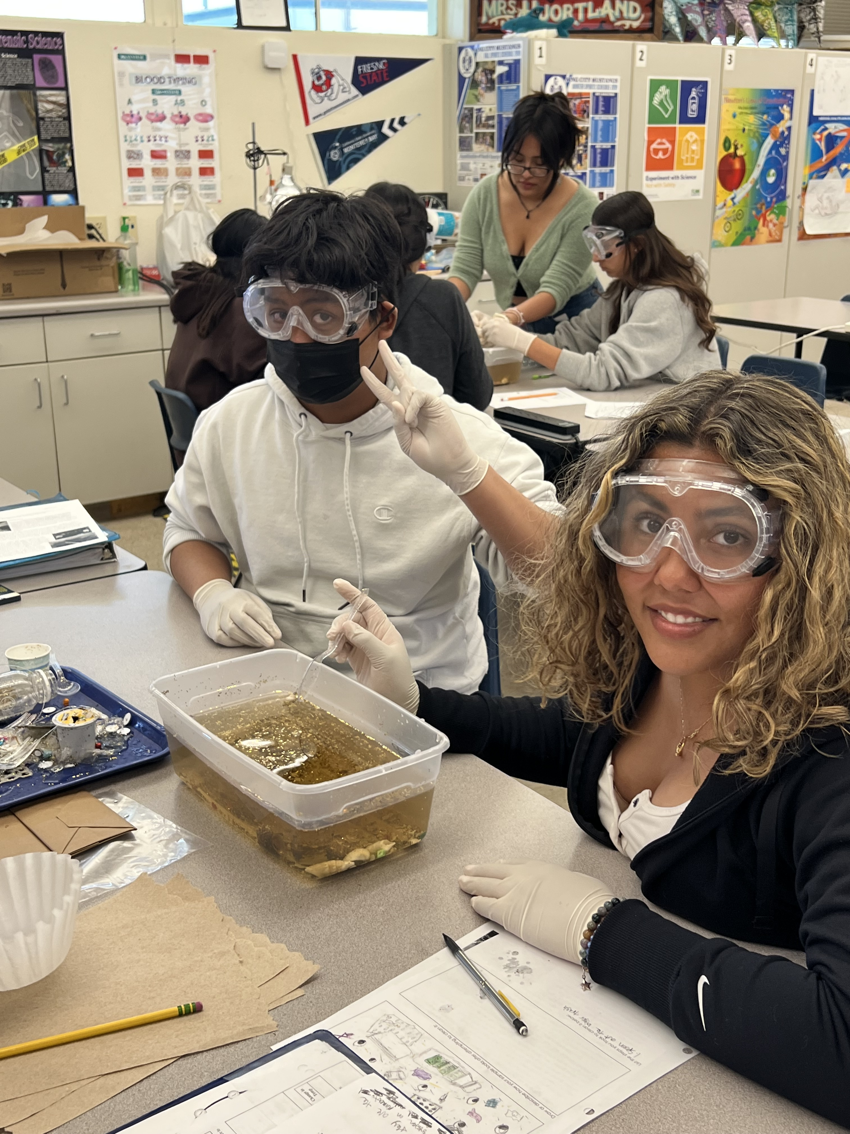
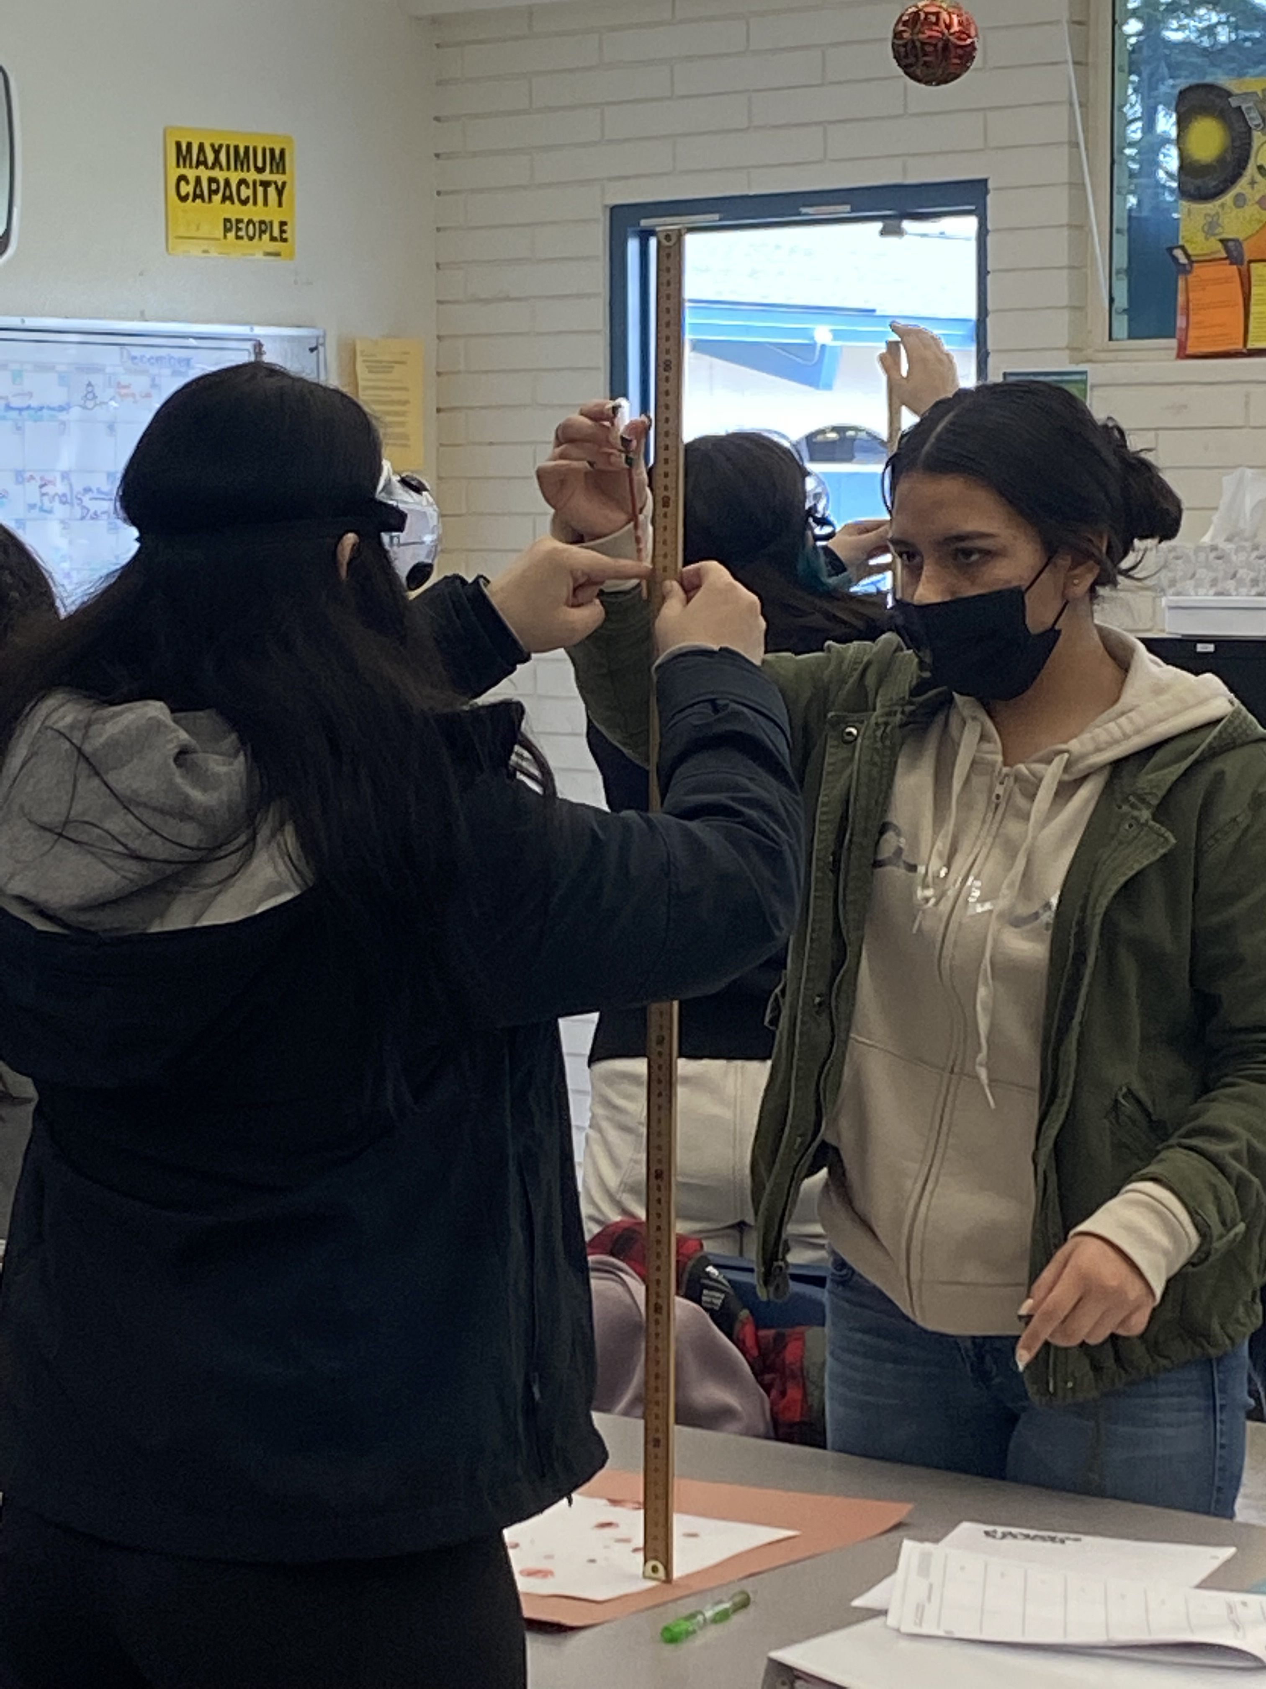
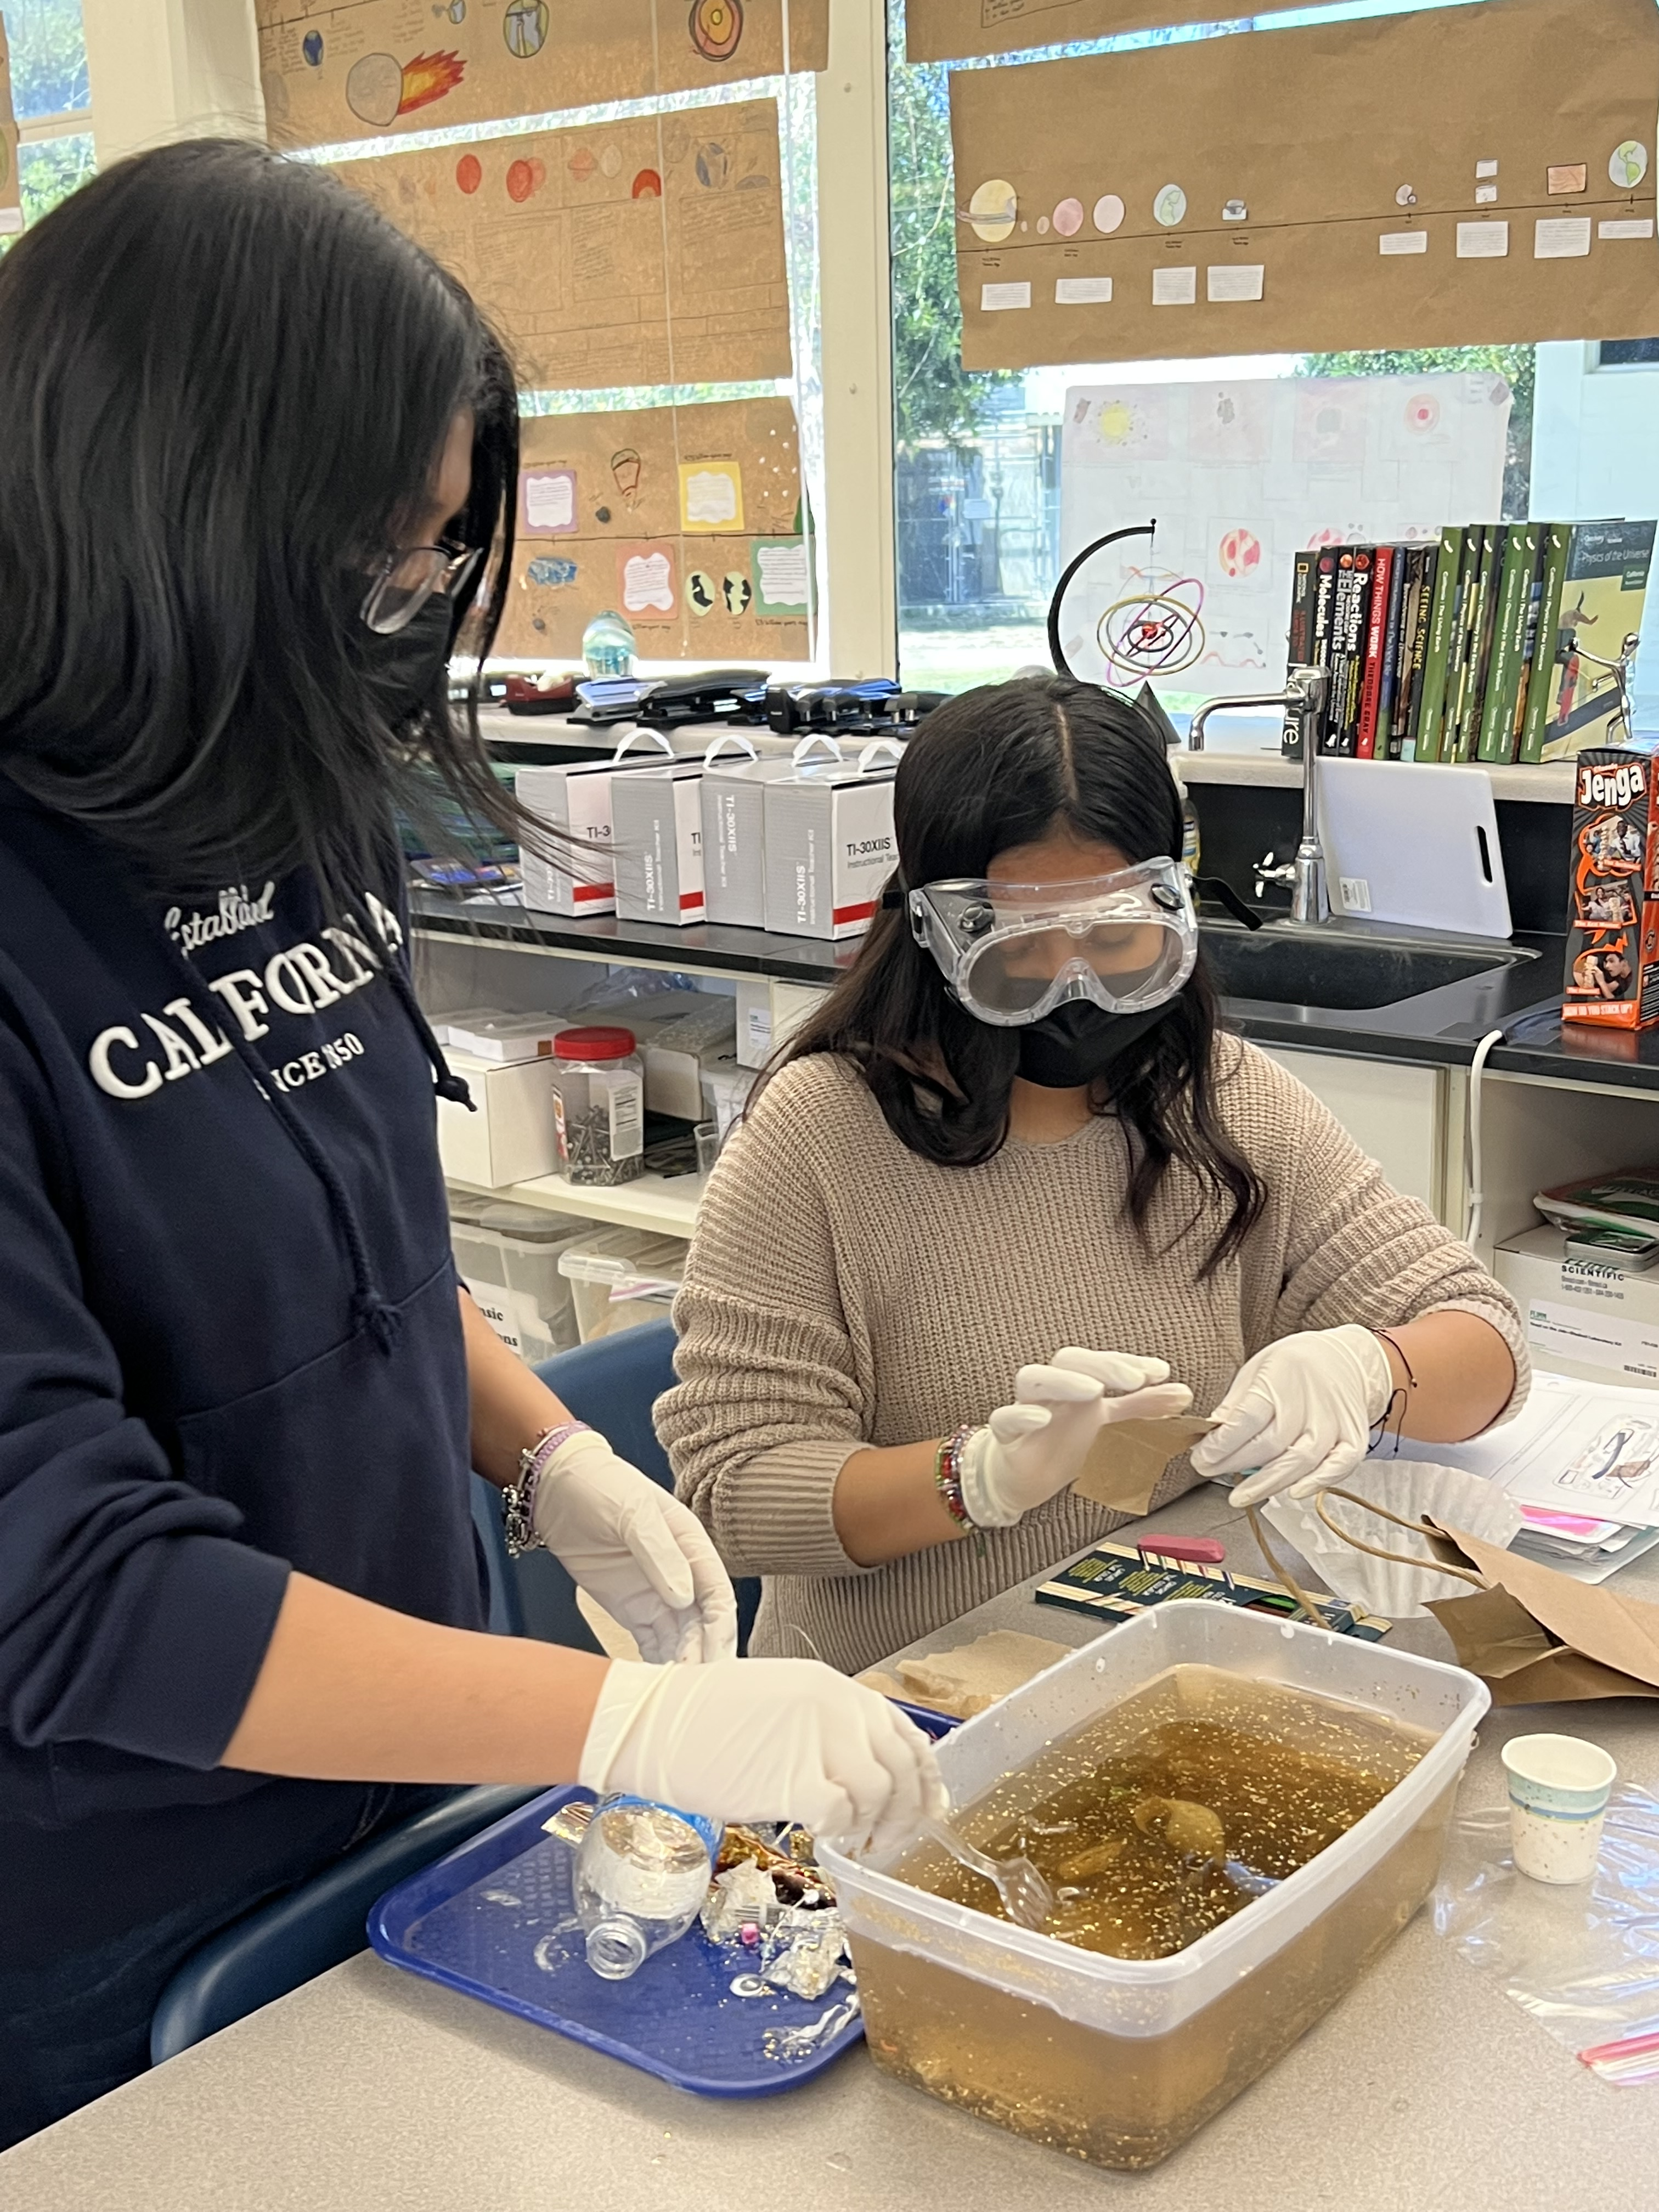
Pursue Careers in:
Environmental
Medical
Forensics

Slide 18

Electives

Slide 19

Agriculture
https://www.youtube.com/watch?v=vCCI1qELzl0

Slide 20
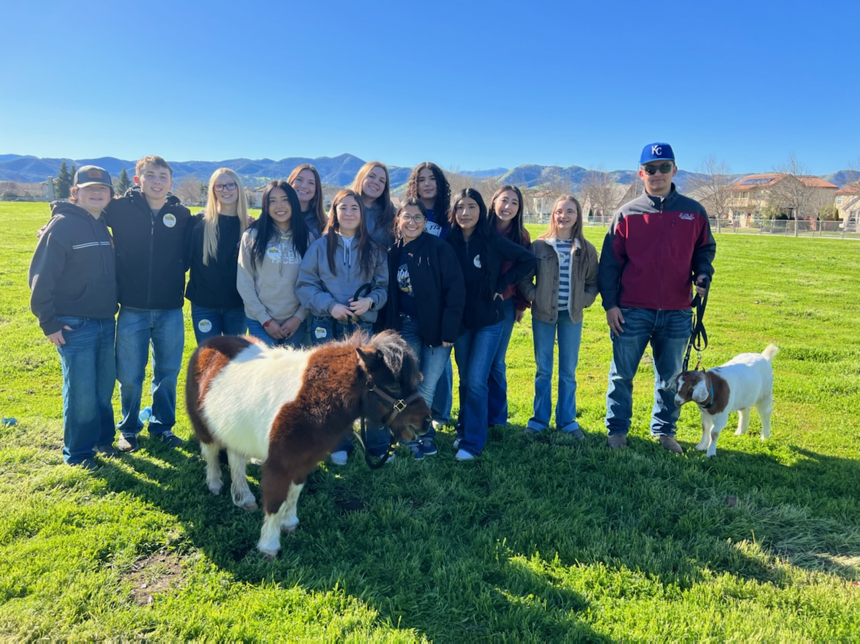
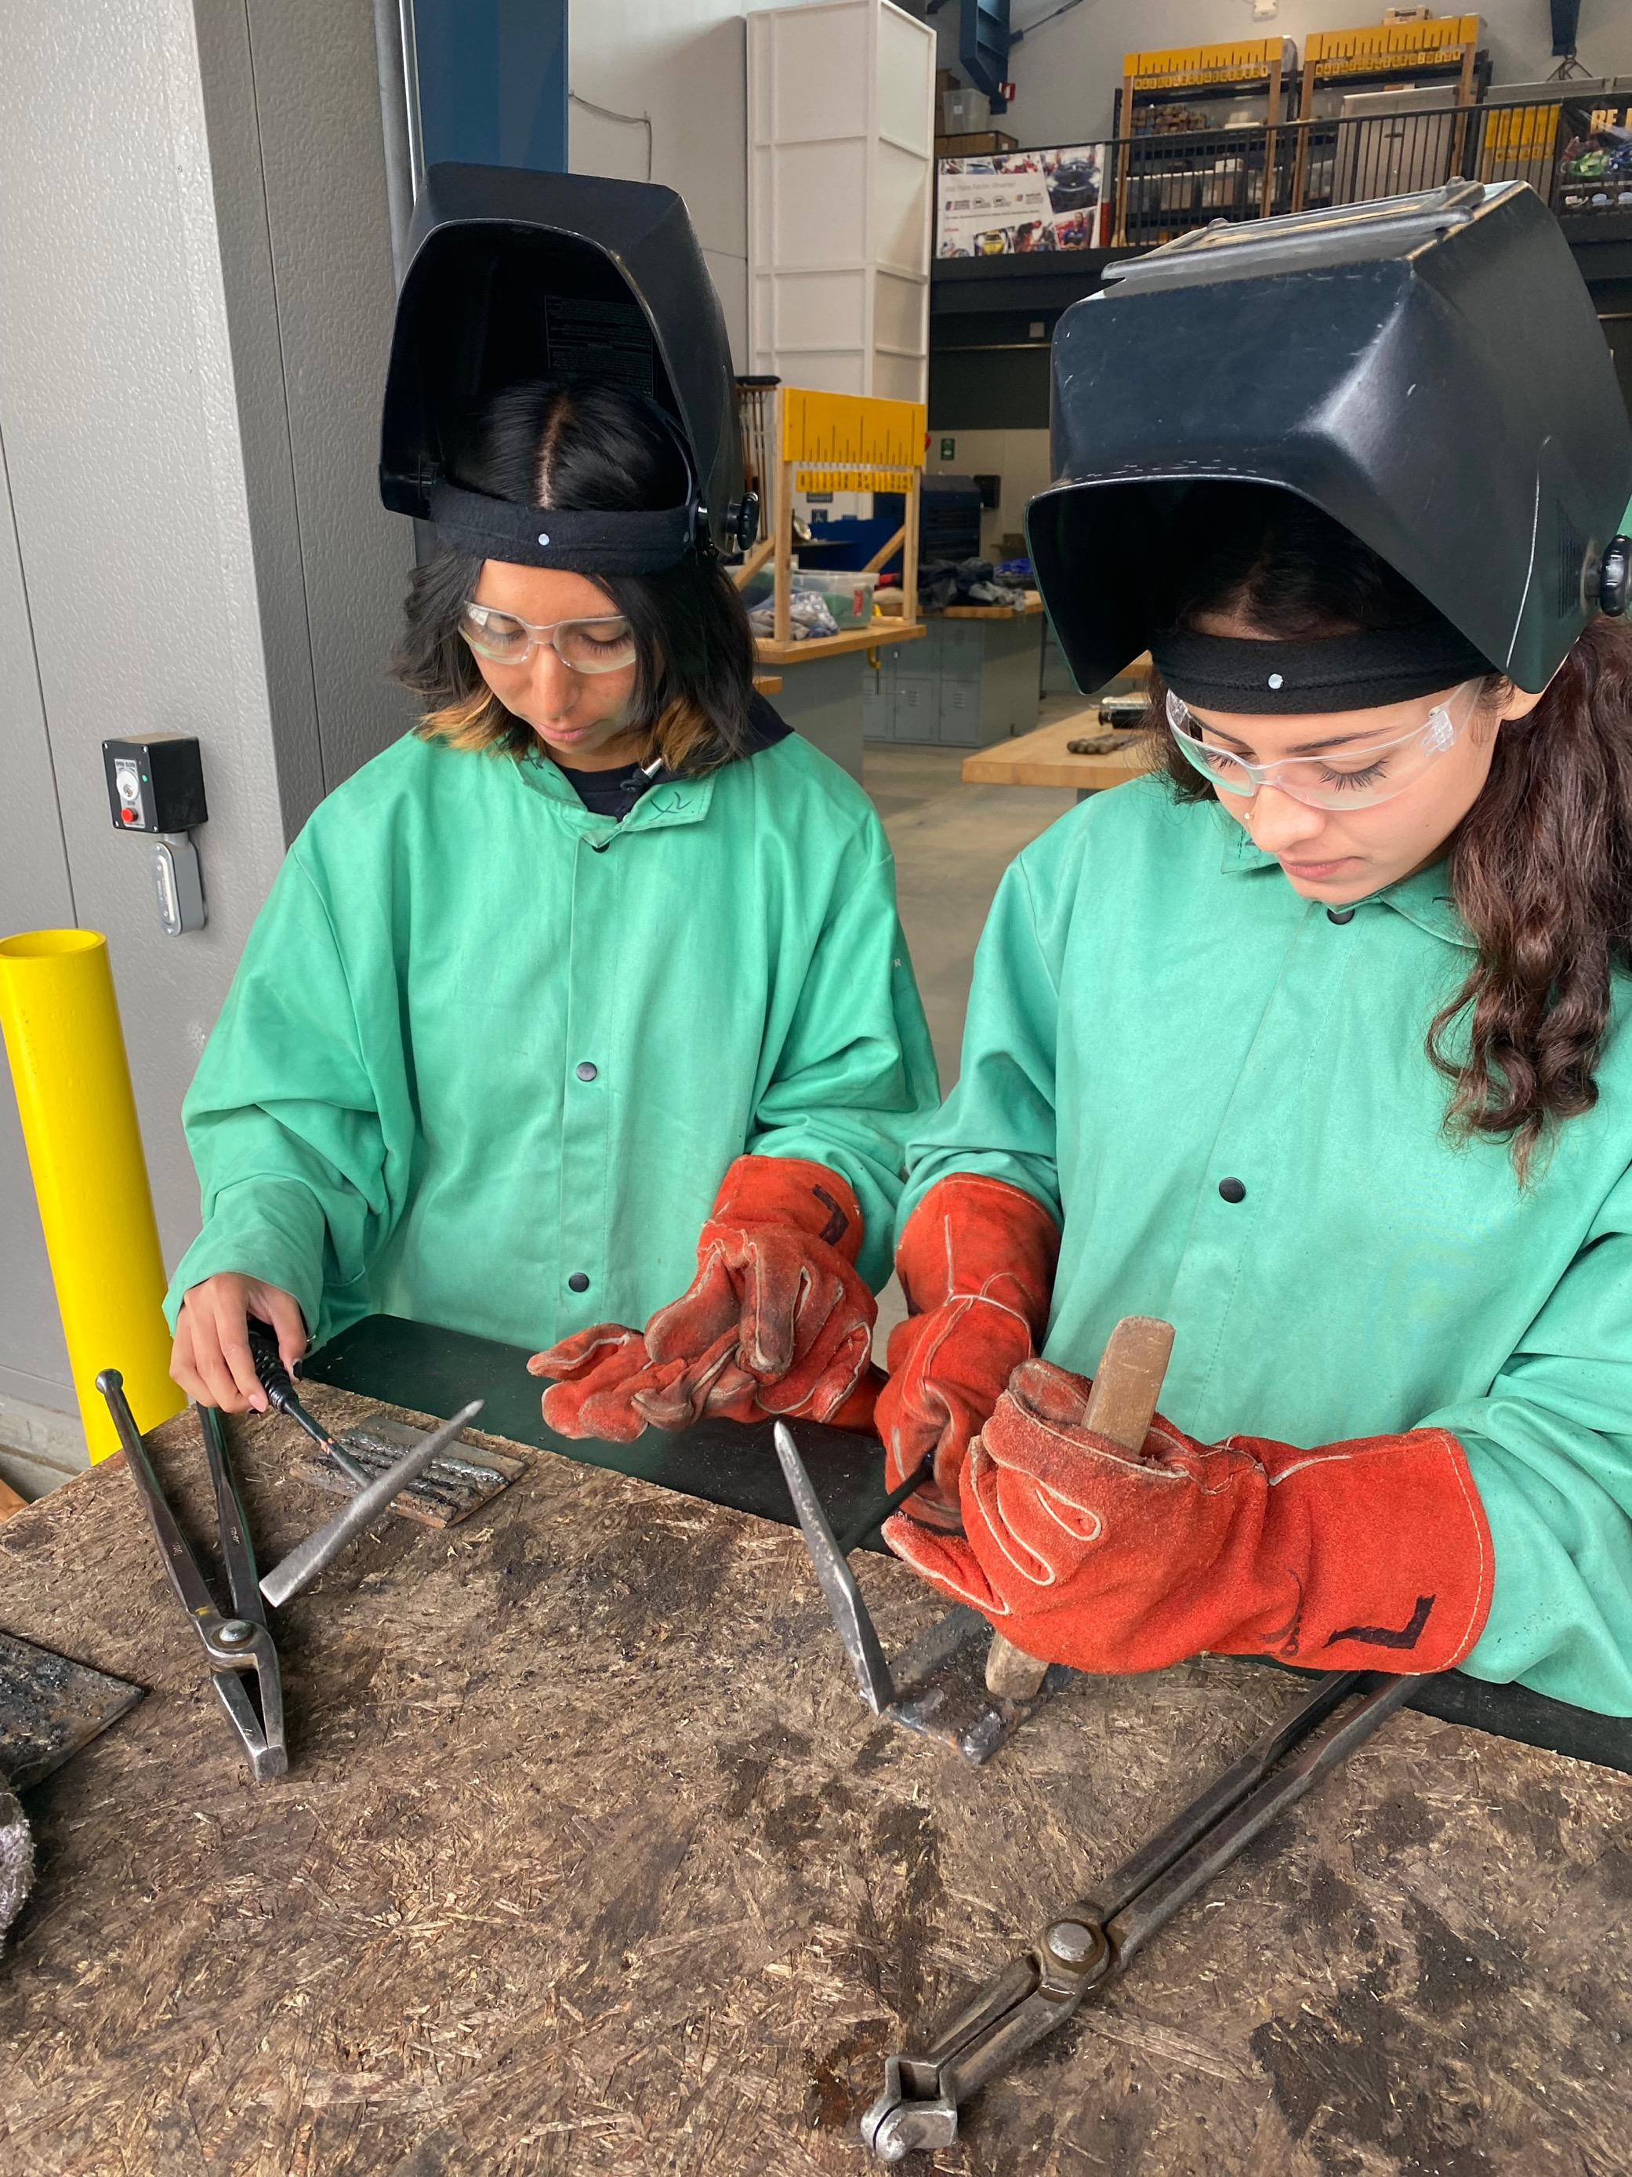
Agriculture Classes for
Freshman
  Ag Science Academy 1
UC/CSU Approved for Laboratory Science (D)/High School Life Science Graduation Requirement
  Ag Science Academy 1 Honors
UC/CSU Approved for Laboratory Science (D)/High School Life Science Graduation Requirement
  Ag Mechanics 1
UC/CSU Approved for College-Preparatory Elective (G)
Horticulture 1
UC/CSU Approved for College-Prep Fine Art (F)
  Floral Design 1

Slide 21
Sequence of Agriculture Courses
(All Classes UC/CSU College Approved
Ag Pathway | 9th Grade | 10th Grade | 11th Grade | 12th Grade
Agriculture Science | Ag Science Academy 1 Ag Science Academy 1 Honors | Ag Science Academy 2 Ag Science Academy 2 Honors | Animal Science | Vet Science Ag Business/Econ
Ag Mechanics | Ag Mechanics 1 | Ag Mech 2 | Ag Mech 3 Small Engines | Ag Mech 4
Additional | Horticulture 1 | Horticulture 2 Landscape Design/ Sports Field Management | Floral Design 1 | Floral Design 2

Slide 22
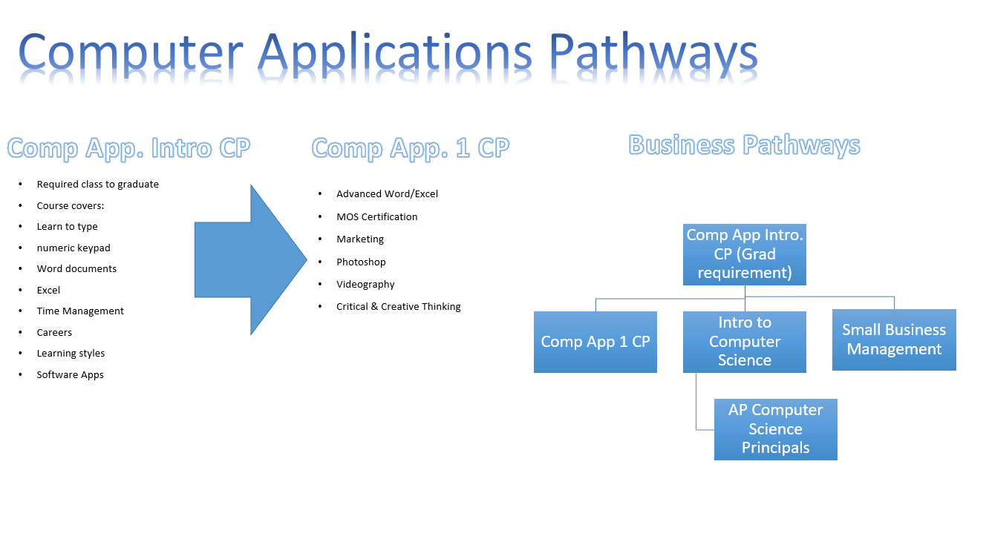
Comp App. Intro CP

Slide 23


Slide 24


Drama Teacher: Ms. Jones
At KCHS we offer Beginning and Advanced Drama courses.
Drama is a great way to build confidence and make friends in a fun and supportive space!
Drama fulfills your Fine Arts elective requirement and is A-G approved
KCHS Dramatics students put on two theatrical productions a year.
Drama is more than just acting! We also learn elements of technical theater:
Costume design
Makeup design and application
Set design and construction
Lighting design
Sound design
Stage management
You don't have to be a performer to get a lot out of drama!

Slide 25

Advanced Placement Human Geography

Slide 26


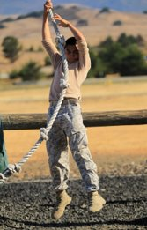
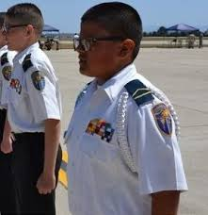
King city High School
Military Science
What is Military Science?
Military Science is an advanced, applied-leadership class that uses military structure to allow for maximum opportunity for leadership and management experience.
Six core objectives for Military Science:
To develop Leadership
To teach Basic Military Knowledge
To engender Citizenship
To foster Academic Excellence
To encourage Patriotism
To promote Health, Fitness, and Wellness
What this class is not:
We are not a military prep program. This is not a military recruitment tool. There are no ties to any armed forces branch recruiting command.

Slide 27
King city High School
Military Science
Class Expectations:
Student must have a current sports physical on record. Students will engage in physical training twice a week. The level of exercise in this class will surpass what is usually seen in traditional PE classes.
Student will wear a cadet Uniform (provided to them) every Wednesday. Uniform must be clean, ironed, well maintained, and worn in accordance to regulation.
Who is this class for?
Students who want to build their leadership skills
Students who want to push themselves, both physically and mentally
Students who have an interest pursuing a career in the military or law enforcement
Summer Training and Events:
California Cadet Corp (CACC) hosts two, week-long, leadership camps during the summer. These camps will be at CAMP SLO, and will prepare your student for success in this class.
Activities throughout the year. We are planning on at least one field outings to CAMP SLO per semester. Typically these will be over a weekend.

Slide 28

King City High School Music Courses
Beginning Guitar – Acoustic classical guitar instruction developing chords and melodies needing no experience
Advanced Guitar – Development of nylon, steel, and electric guitars. Included in that is the development of garage band style instruction who will perform at sporting events and concerts. Prerequisite: Beginning Guitar
Percussion 1: Students desiring percussion instruction which needs no experience.
Percussion 2: Percussion ensemble-based instruction needing some musical background knowledge.
Beginning Band – A Performance-based class on woodwind, brass, and percussion instruments with no experience necessary.
Advanced Band – Also known as the Mustang Marching Band, this performing ensemble plays at football, basketball, and concert venues. This group travels to Magic Mountain in May. Experience is necessary and, if you play percussion, an audition process will happen from March 2024 through April.

Slide 29
Which Band class do I sign up for?
No music: Beginning Band, Beginning Guitar, or Percussion 1
Experience in band, guitar, and percussion techniques: Advanced Band, Advanced Guitar, or Percussion 2
Band instruments used in Beginning Band include:
  Flute, Clarinet, Alto Saxophone, Tenor Saxophone, Baritone Saxophone, Trumpet, French Horn, Trombone, Baritone, Tuba, and Percussion.
Band instruments used in Advanced Band include:
  All of the instruments mentioned above including Oboe, Bass Clarinet, and Marching horn and percussion instruments.

Slide 30

Which Guitar Class Do I Sign up for?
If you do not know how to read music or play the guitar*, sign up for Beginning Guitar. (Most freshman take Beginning Guitar)
You MUST know how to read music to be in Advanced Guitar
Beginning guitar players will learn
  How to play CLASSICAL guitar
  How To read music
  How To play chord/ chord shapes
  How to collaborate/ duet with other guitarists

Slide 31
Music Courses show discipline and creativity!
All students must have Beginning Band or Beginning Guitar or Percussion 1 experience before they join an Advanced ensemble.
Many students remain in our advanced band/guitar class during their 2nd, 3rd, and 4th year on campus
Colleges love to see music program experience on an applicant's resume!
  It shows that a student is devoted, is a team player, and knows how to work well with others.

Slide 32


The CTE Patient Care Pathway started this year (2024-2025) at KCHS.
Next year (2025-2026), KCHS will offer the Patient Care Capstone course to 12th grade students.

Slide 33
CTE Patient Care Pathway
Course Sequence
CTE Health Science & Medical Technology Industry Sector | 10th grade | 11th grade | 12th grade
Patient Care Pathway | Introduction to Healthcare Careers | Medical Terminology | Patient Care Capstone*
 | UC-approved for area G (college prep elective) | UC-approved for area G (college prep elective) | *Pending UC-approval for area G (college prep elective); will be submitted February 1, 2025.

Slide 34
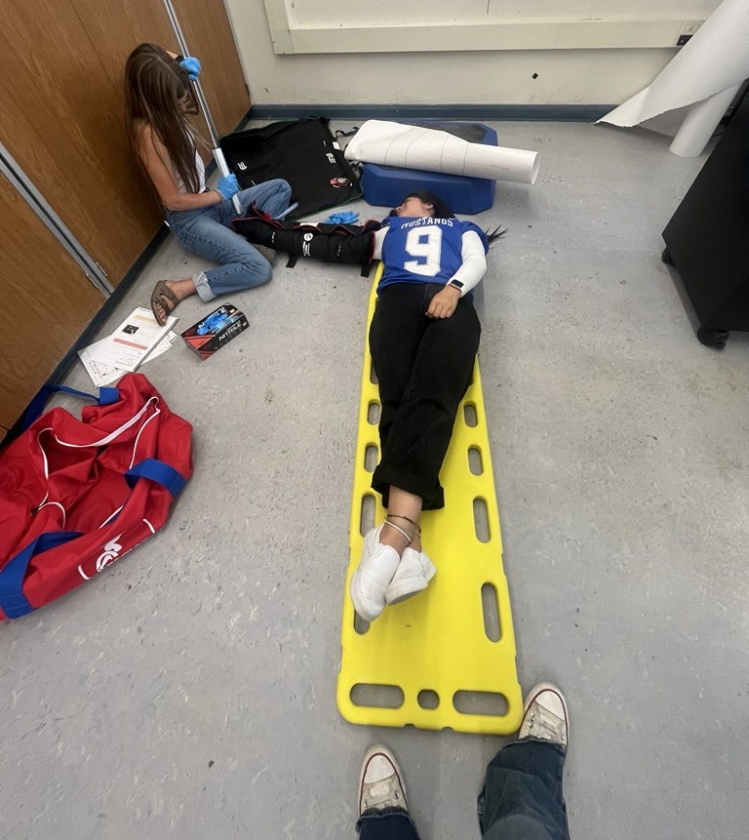
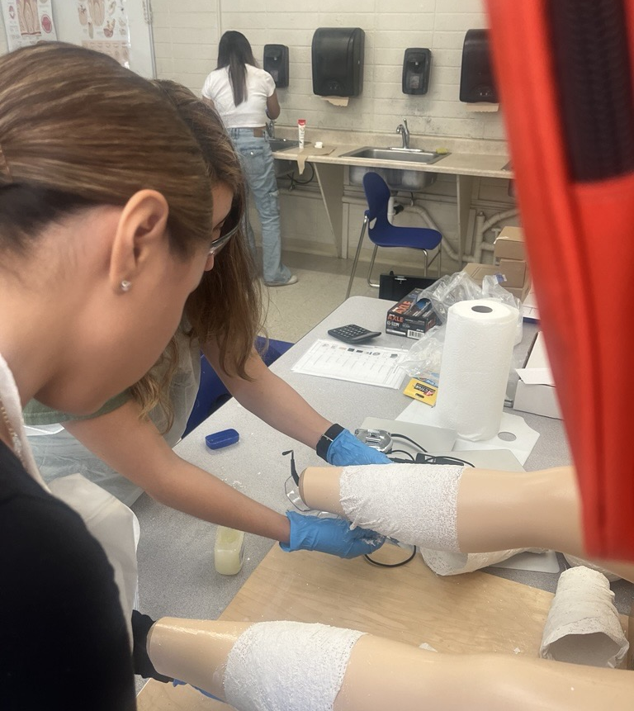
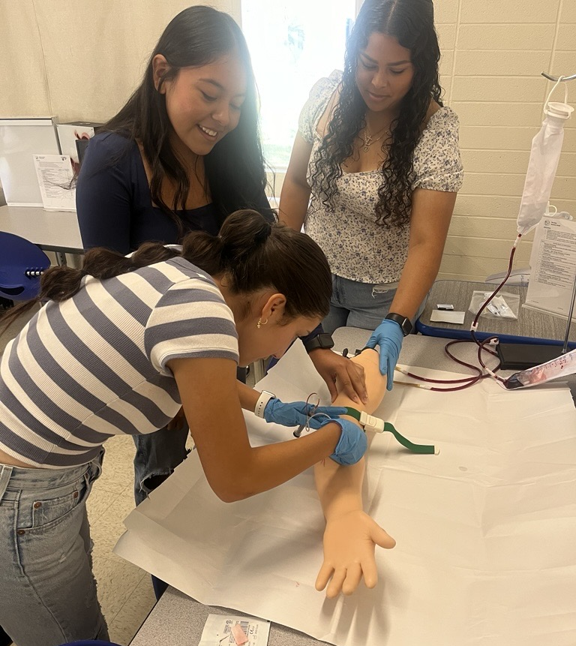
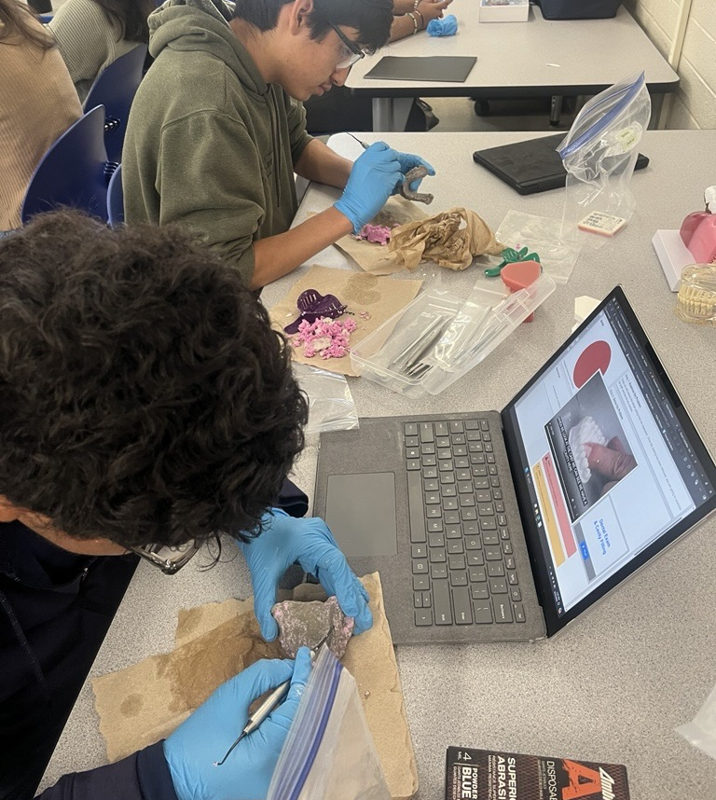
Introduction to Healthcare Careers (CTE Introductory Course)
Students experience 17 Health Science Career modules.
This Project-based Learning course is 70% hands-on.
The modules include Nursing, Biomedical Engineering, Medical Imaging, Pharmacy Tech, and Dentistry.

Slide 35
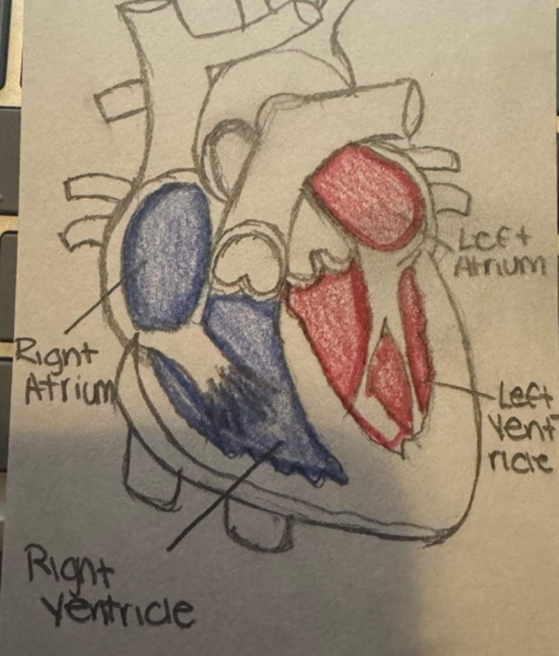
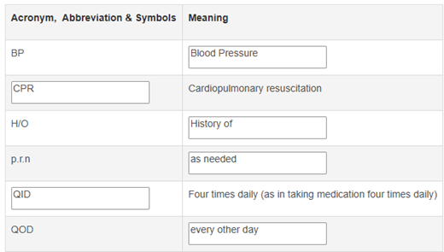
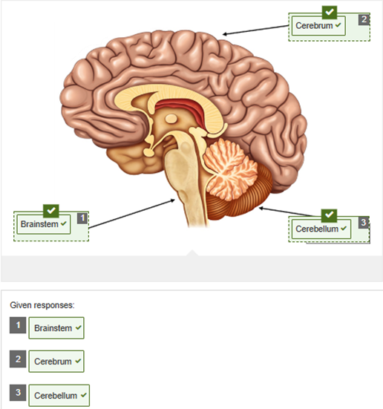
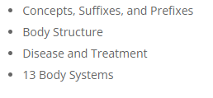
Medical Terminology
(CTE Concentrator Course)
This course introduces students to the structure of medical terms and medical abbreviations so that students can comprehend medical vocabulary appropriate to medical procedures and patient care.

Slide 36

Patient Care Technician
(CTE Capstone Course)
The capstone course allows 12th grade students who have a foundation in health science to gain multiple proficiencies, including nurse assistant, phlebotomy, and electrocardiography. Students will also learn the highest standards in work ethic and personal responsibility.
The Patient Care Capstone will begin in the 2025-2026 school year. Students in the course will also complete an internship as part of their preparation for taking the National Healthcareer Association (NHA) examination to become Certified Patient Care Technicians.

Slide 37
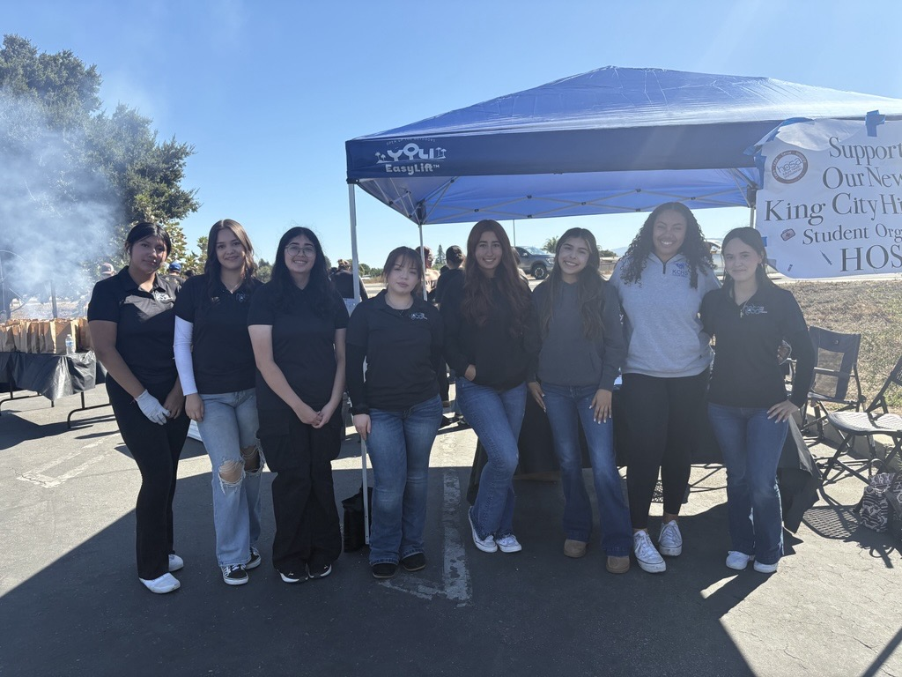


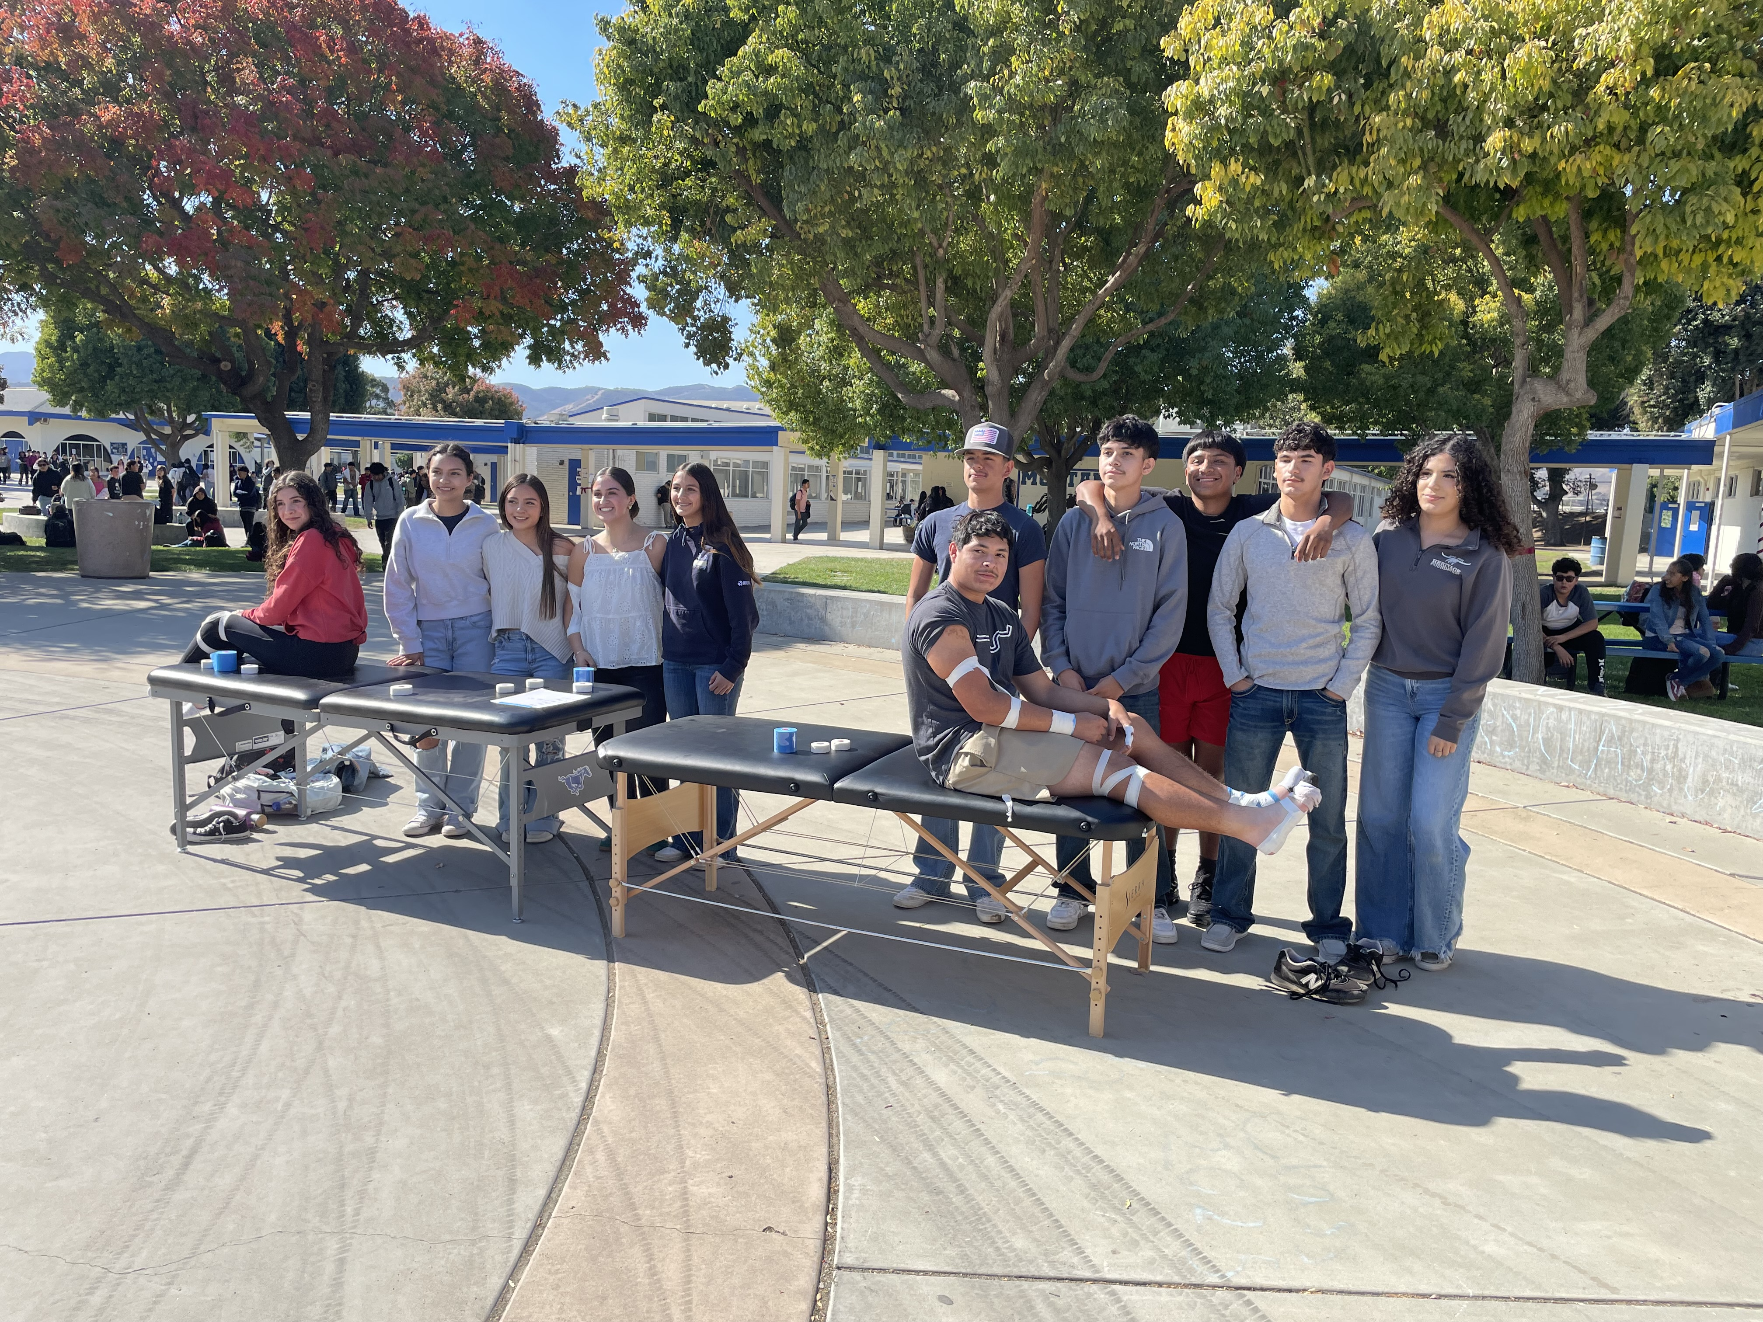
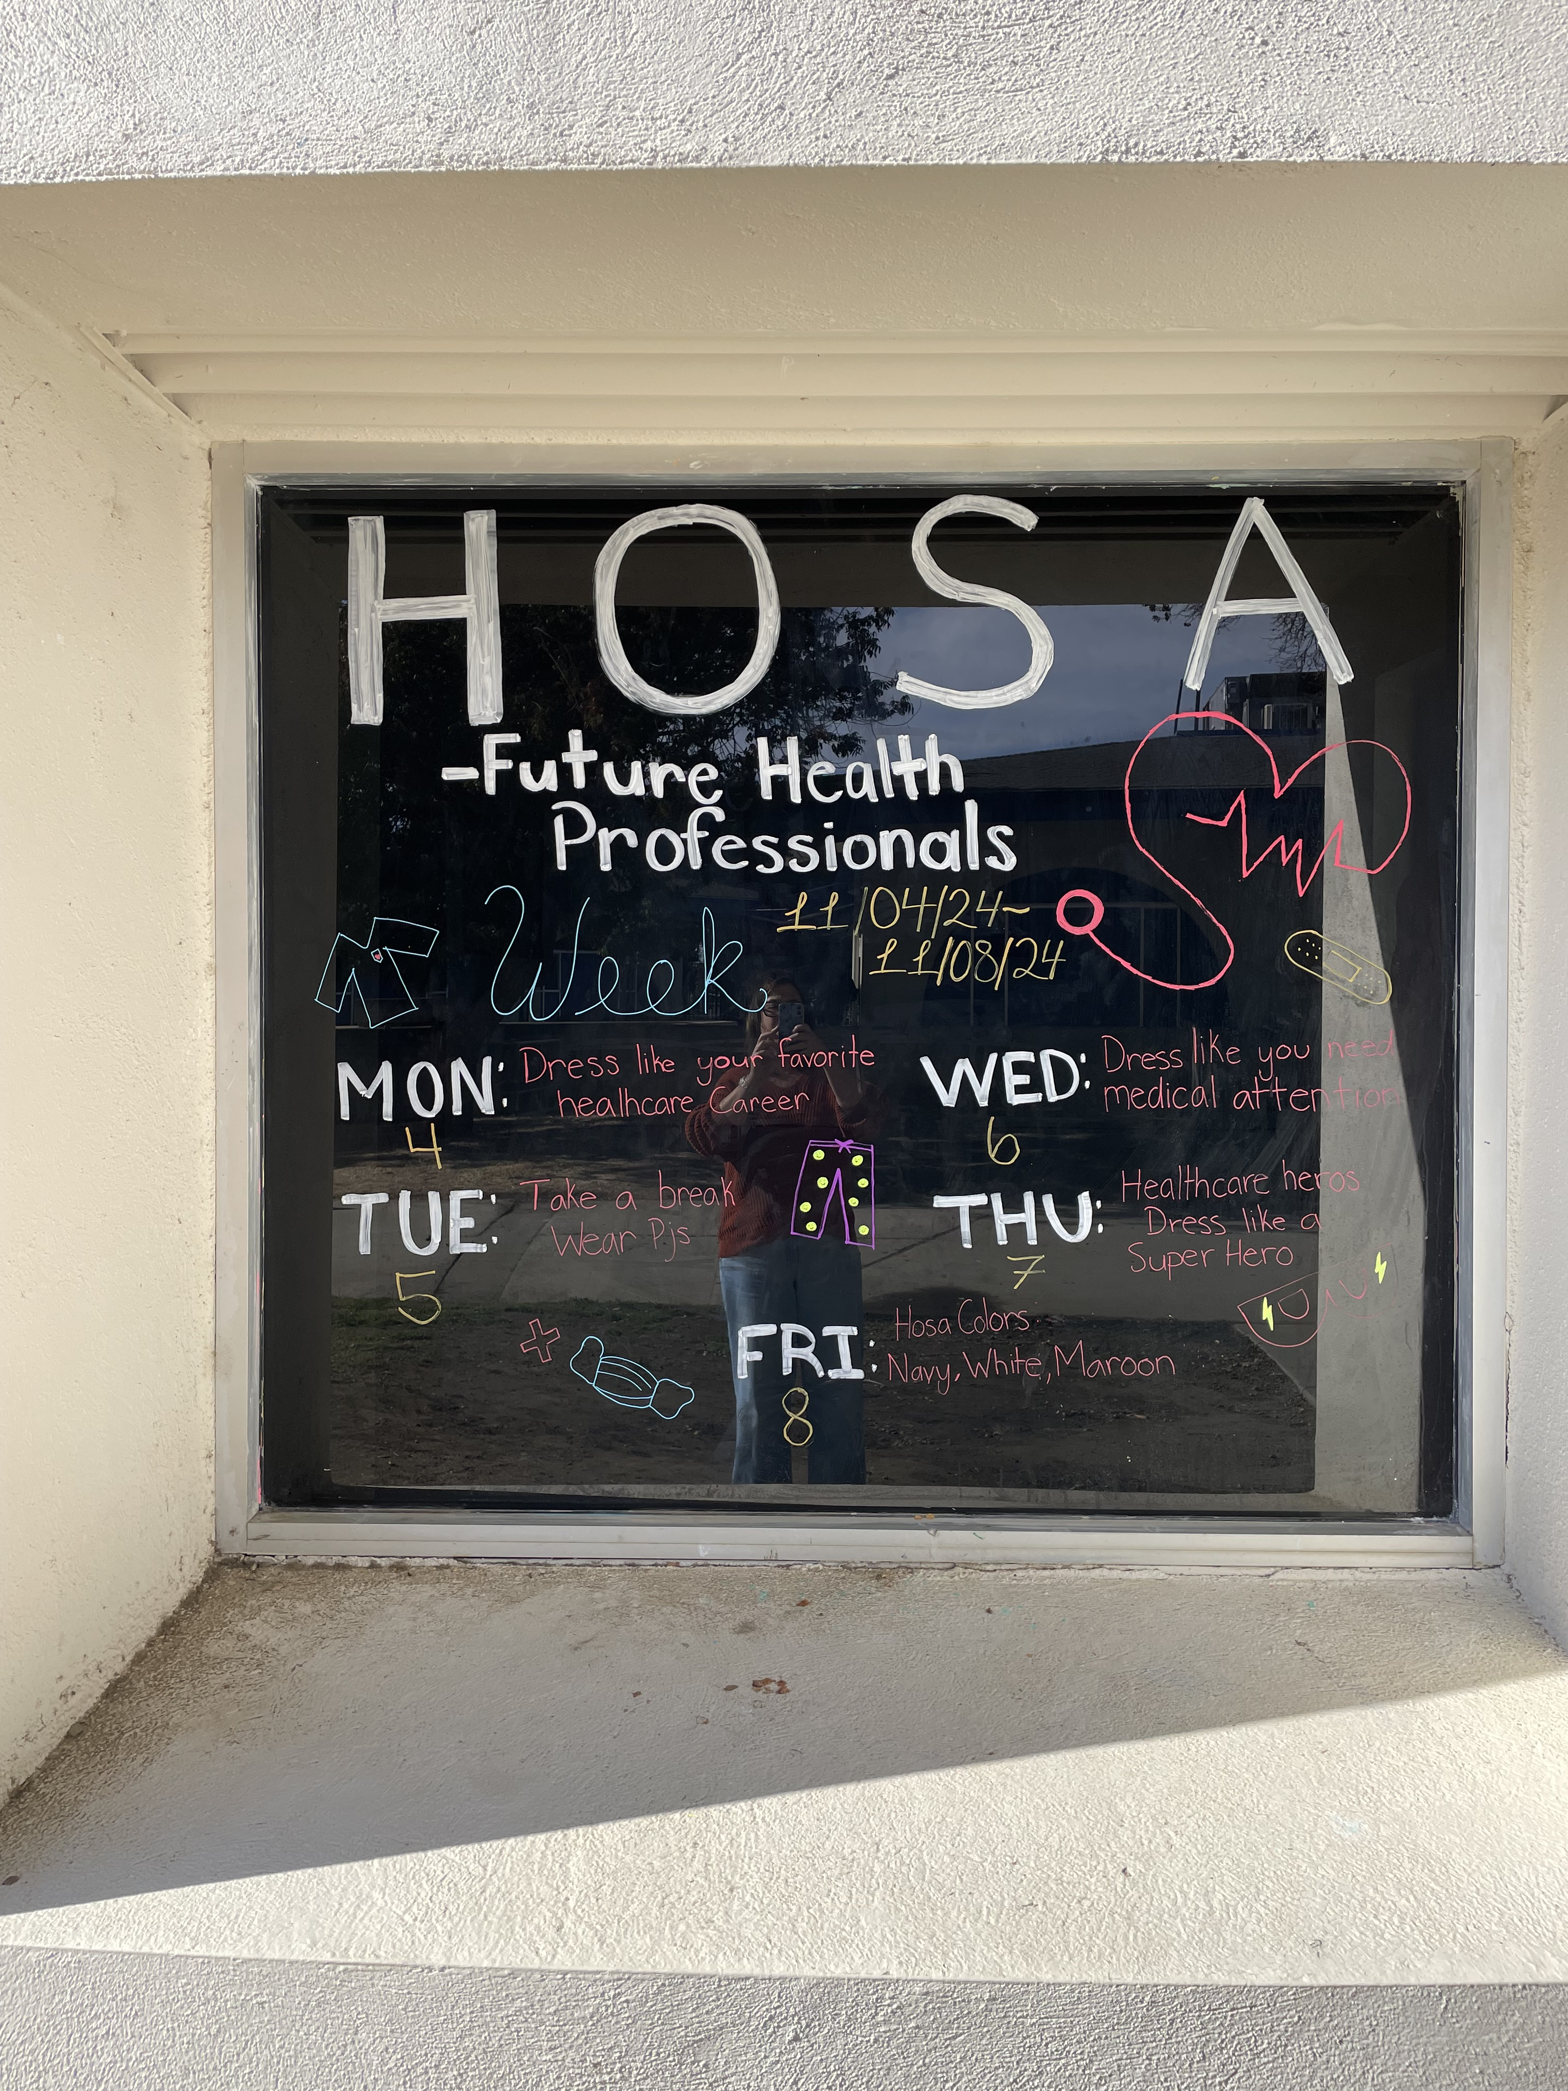
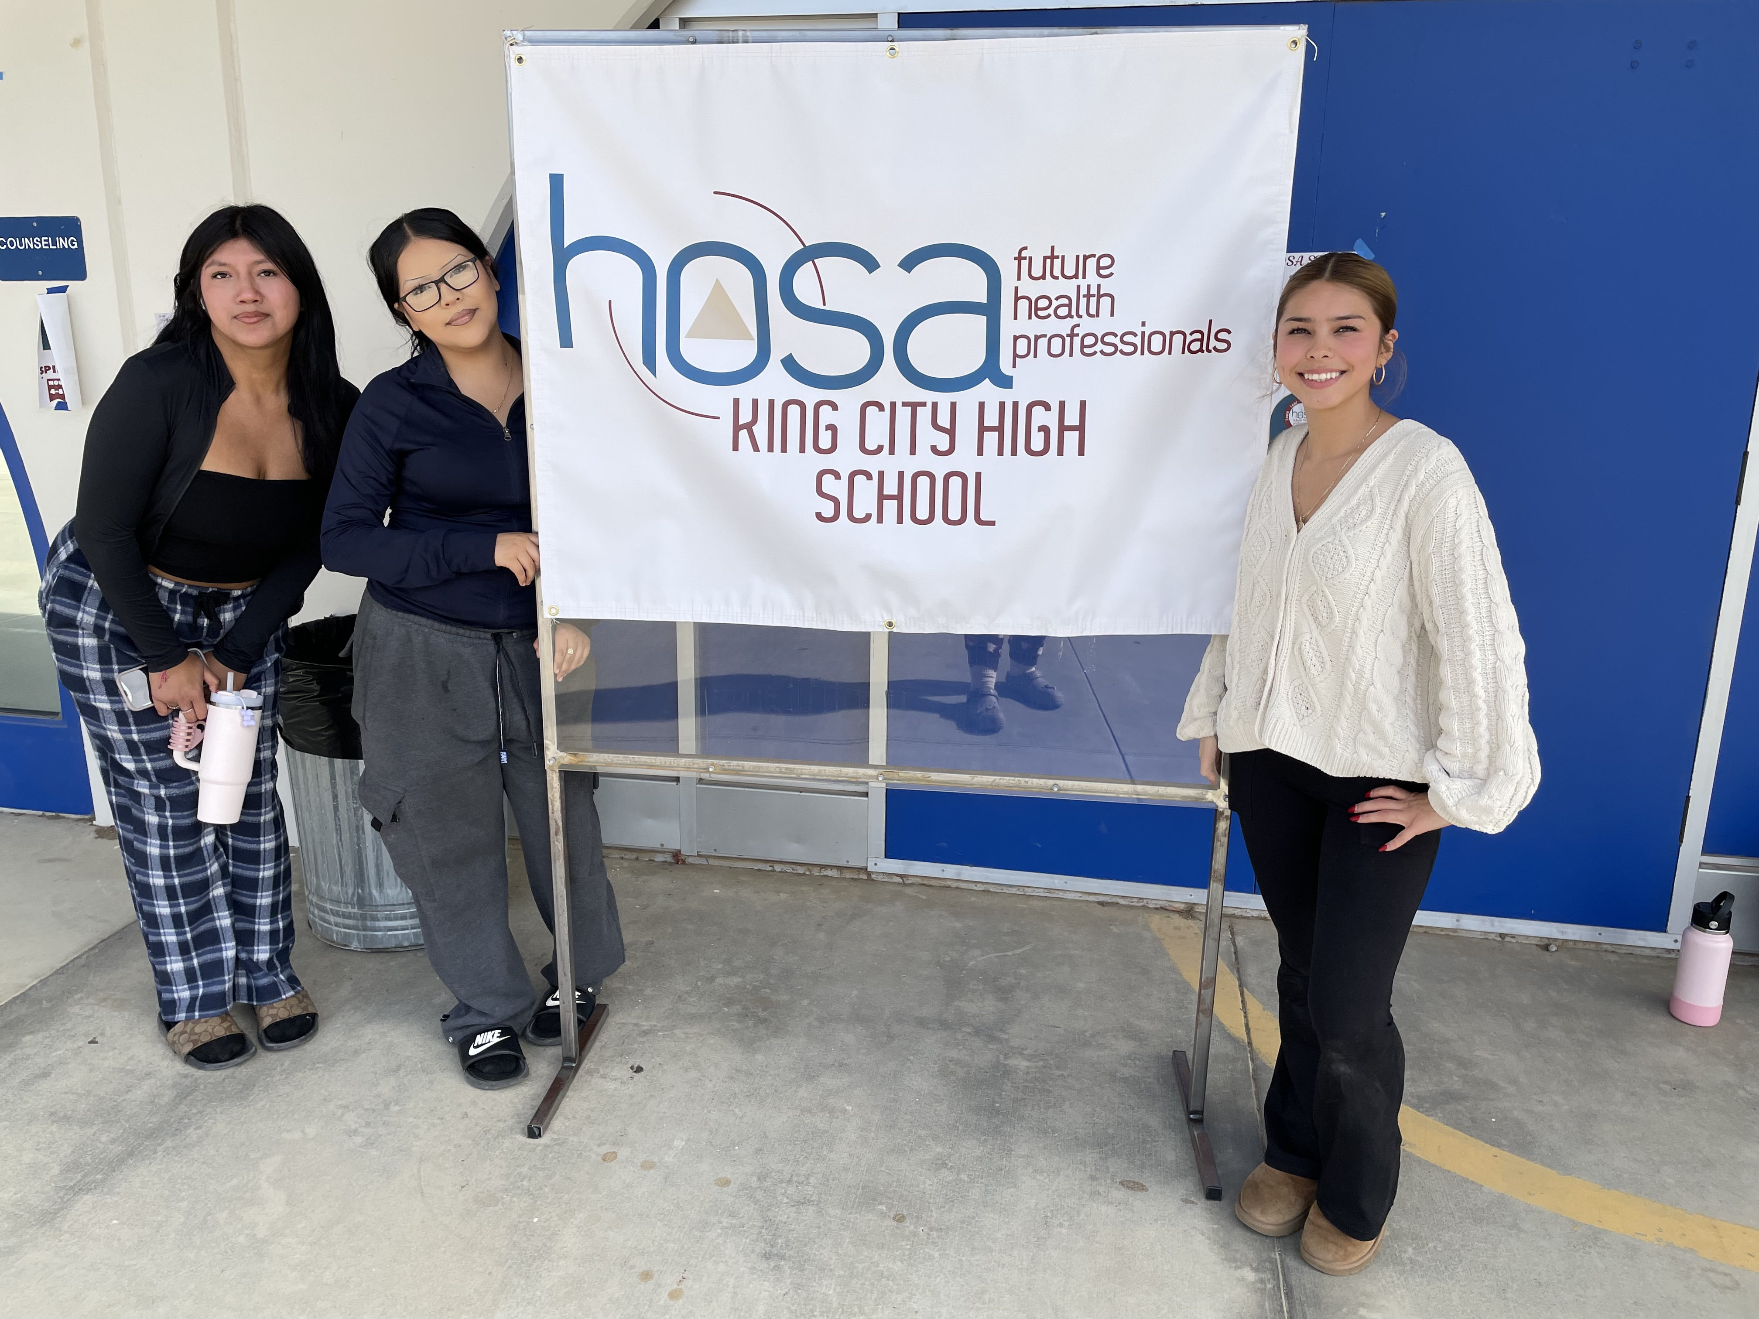

HOSA-Future Health Professionals (CTE Student Leadership Organization)
HOSA-Future Health Professionals provides opportunities for students to develop, practice, and refine their technical, leadership, and team skills to achieve a seamless transition from education to a health profession.
More than 250 KCHS students enrolled in the Patient Care or Sport Medicine pathways are members of the HOSA Student Leadership Organization.
HOSA offers more than 80 competitive events at the State Leadership Conference in Sacramento in March 2025. KCHS students will travel to the SLC and compete against other HOSA chapters in several events.

Slide 38
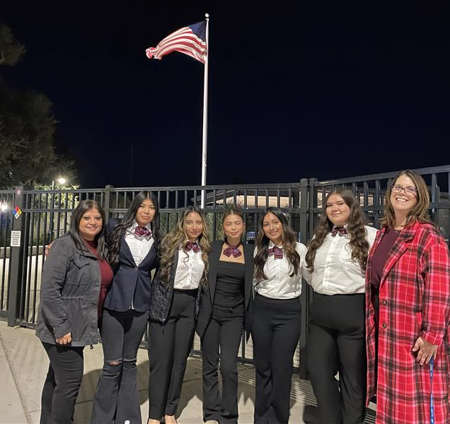
Patient Care Pathway Advisors/Instructors:
Melissa Manriquez mmanriquez@smcjuhsd.org 831-385-5461 ext. 1172
Stacey Callarman scallarman@smcjuhsd.org 831-385-5461 ext. 1161

Slide 39

Sports Medicine Care and Prevention of Injury
Athletic Training 1 -
Theory of athletic training
Hands on learning
Anatomy/Physiology
Afterschool lab working with athletic teams
Athletic Training 2 -
Further in-depth theory of athletic training and hand on learning
Continued afterschool lab working with athletic teams
In game athletic training

Slide 40

Sports Medicine Personal Training
Personal Training 1 -
Theory of personal training
Hands on learning
Anatomy/Physiology
Afterschool lab working with athletic teams
Personal Training 2 -
Further in-depth theory of personal training and hands on learning
Continued afterschool lab working with athletic teams
During school assisting of athletic strength and conditioning classes/Internship with local businesses

Slide 41

Sports Medicine Potential Careers/College Opportunities
Athletic Trainer
Physical Therapist
EMT
Medical Doctor/Orthopedist
Student Assistant Athletic Trainer while in college
Educator
Personal Trainer
Strength and Conditioning Coach
Professor
Student assistant while in college
Gym Manager
Gym Owner

Slide 42
Sports, Clubs and more

Slide 43
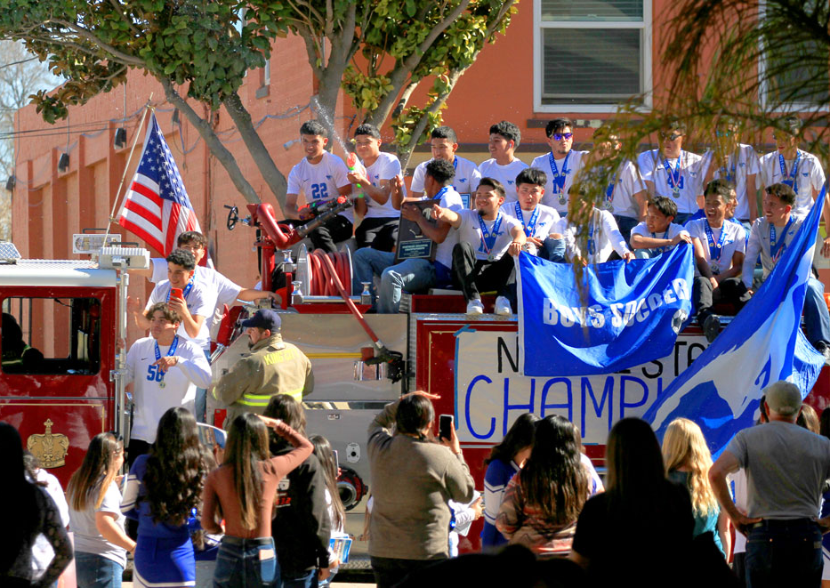
King City High School Athletics
High School Athletics are:
  Vital to the positive social, physical, and educational development of students.
  A privilege that help develop good citizenship and academic performance.
High School Athletic are in place to:
  Help the individual student develop healthy habits.
  Encourage leadership, use of initiative, and good judgment.
  Teach life lessons of hard work and perseverance.
Students who participate in High School Athletics and clubs are more likely to graduate from High School than their peers.

Slide 44
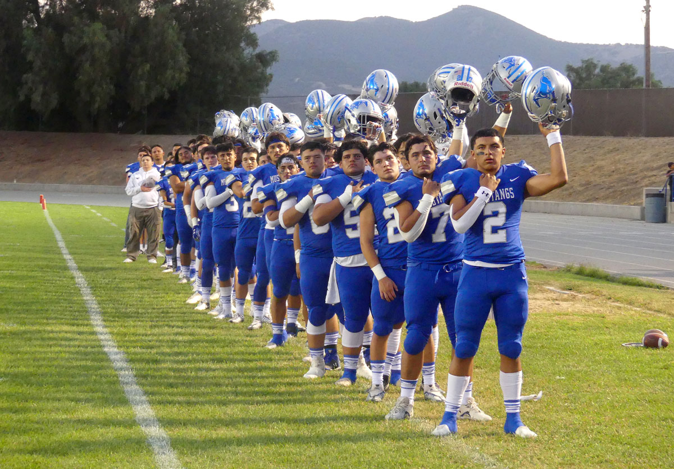
Sports at King City High School
Fall Season – Starts in August
  Football
    11-Man Tackle
    Girls Flag Football
  Cheer
  Cross Country
  Girls Golf
  Girls Volleyball
Winter Season – Starts in November
  Girls and Boys Basketball
  Girls and Boys Soccer
  Wrestling
  Competitive Cheer
Spring Season - Starts in February
  Baseball
  Softball
  Track and Field
  Swimming
  Boys Golf

Slide 45

ASB LEADERSHIP
ADVISOR- Lauren Page
Leadership is open to 11th & 12th grade students
A class 9th grade students can look forward to & get in volved on campus
Many events underclassmen can participate in.
Follow us on Instagram for updates on school events & activities
@kchsmustangleadership

Slide 46
Class Involvement
Class Advisors:
C/O 2026: Mrs. Manriquez
C/O 2027: Mrs. Munoz
C/O 2028: Ms. Jones
C/O 2029: TBD
*Parent involvement is always & greatly appreciated:
Concession Stands, Homecoming, etc.
*Help your student get involved on campus!
Class Officers Needed:
President
Vice President
Secretary
Treasurer
Class Rep
*Sign Ups and voting happen at the start of school year with Mrs. Page (Leadership)

Slide 47
Clubs
Skills USA Club
STEM Club
CSF
Mustangs Yearbook
Journalism
Drama Club
FFA
Writing Mustangs
Rotary Interact Club
ASB Leadership Club
E.A. Sports
Sports Management
Tennis
KCHS Music
Photo
HOSA
& more!!!

Slide 48


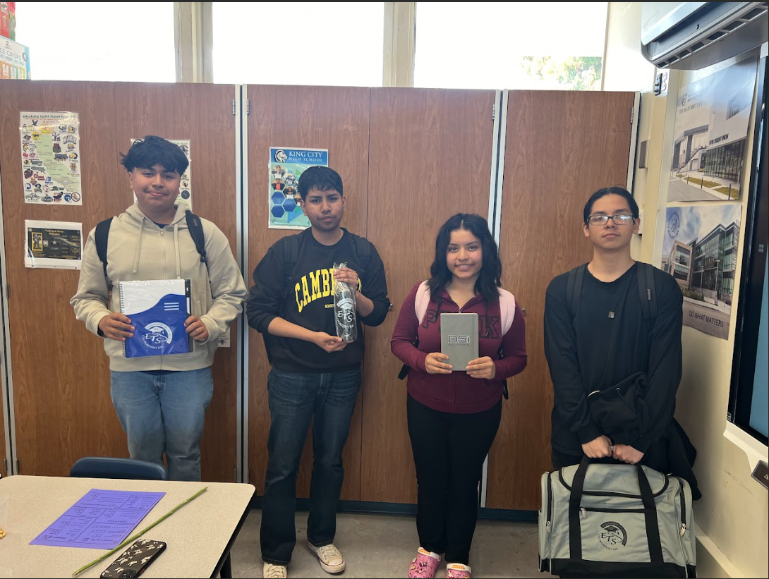
  FAFSA , Scholarships , etc..

